Slide 1
Accessibility Program Managers Meeting
August 1, 2019

Slide 2
Digital Dashboard
Accessibility Module
Michael Horton | August 1, 2019

Slide 3
GOAL: To provide an overview of the purpose, uses, and function of the Digital Dashboard Accessibility module.

Slide 4
Agenda

Slide 5
Today’s Agenda
Training Objectives
Accessibility Module Purpose and Benefits
Accessibility Module Audience
Accessibility Module Limitations
Using the Accessibility Module
Putting the Accessibility Module to Work

Slide 6
Training Objectives

Slide 7
Training Objectives
Describe the purpose of the Accessibility module of the Digital Dashboard.
Describe the benefits of using the Accessibility module to help monitor your agency’s website Section 508 conformance.
Describe who is eligible to, and how to gain access to the Accessibility module.
Describe the limitations of the information provided through the Accessibility module.

Slide 8
Training Objectives, cont.
Describe how agency websites are scanned for conformance errors, including frequency and types of errors.
Identify the ways that data can be parsed and/or sorted.
Identify the report export capabilities of the Accessibility module.

Slide 9
Accessibility Module Purpose and Benefits

Slide 10
POLL: Have you visited the Accessibility Module?
Yes
No

Slide 11
Accessibility Module
Purpose
Perform a bi-weekly check of over 1000 domain home pages to identify three accessibility issues.
Provide a means for government-wide measurement of adherence to the Standards.
Provide an indication of how seriously an agency takes conformance.

Slide 12

Accessibility Module
Benefits
Provides a tool to help monitor your agency’s conformance.
Helps identify conformance issues that can be easily resolved.
Allows you to track and measure your performance across component agencies.
Help to identify common patterns and trends in conformance.

Slide 13

Why Accessibility Matters
Citizens rely on their government for a range of essential services.
When this information is presented in a way that is not accessible to people with disabilities, those people are shut out from essential services.
Accessibility is the law, and it is everyone’s responsibility.

Slide 14
Accessibility Module Audience

Slide 15
Audience
Access is granted to users with a MAX account
Information contained in the Accessibility Module many be useful to:
Section 508 Program Manager and other persons responsible for conformance
Agency Chief Information Officer (or designated representative)
Content manager
Programmer and other member of the technical development team
GSA/OMB for semi annual reports of program maturity

Slide 16
Accessibility Module Limitations

Slide 17
Limitations
Tool currently scans for only three potential issues, which is a small percentage of compliance criteria.
Tool only scans the home page of each website.
Contrast can only be tested for color assigned programmatically
Graphic text contrast is not tested
Tool won’t uncover errors for empty alt tags or inadequate text descriptions.
Reports must be supplemented by other more robust tools and manual testing.

Slide 18
Using the Accessibility Module

Slide 19
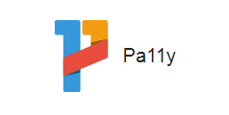
How It Works
Uses open source Pa11y testing engine.
Performs a bi-weekly scan of the home page for all federal government websites

Slide 20
Conformance Issues
Bi-weekly website scans identify three types:
Color Contrast
HTML Attributes
Missing Descriptions
Identifies programmed elements where there is not enough color contrast between text and its background.
Identifies images and other non-text content that are missing a text description.
Identifies anchor elements with a valid attribute, but where no link content has been supplied.
Identifies anchor element with no link content and no name and/or ID attribute.
Conformance requires enough contrast so that text can be read by people with moderately low vision (specifically a contrast ratio of 4.5:1).
Full conformance requires that sufficient information about all user interface components is available to assistive technology.
Full conformance requires a meaningful text description. This requires manual inspection.

Slide 21
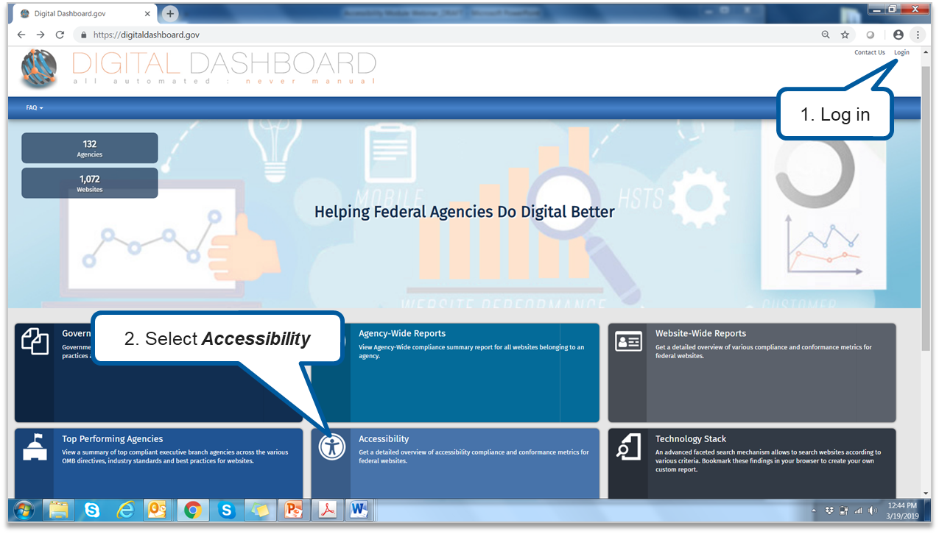
Navigating to the Accessibility Module
https://digitaldashboard.gov/

Slide 22
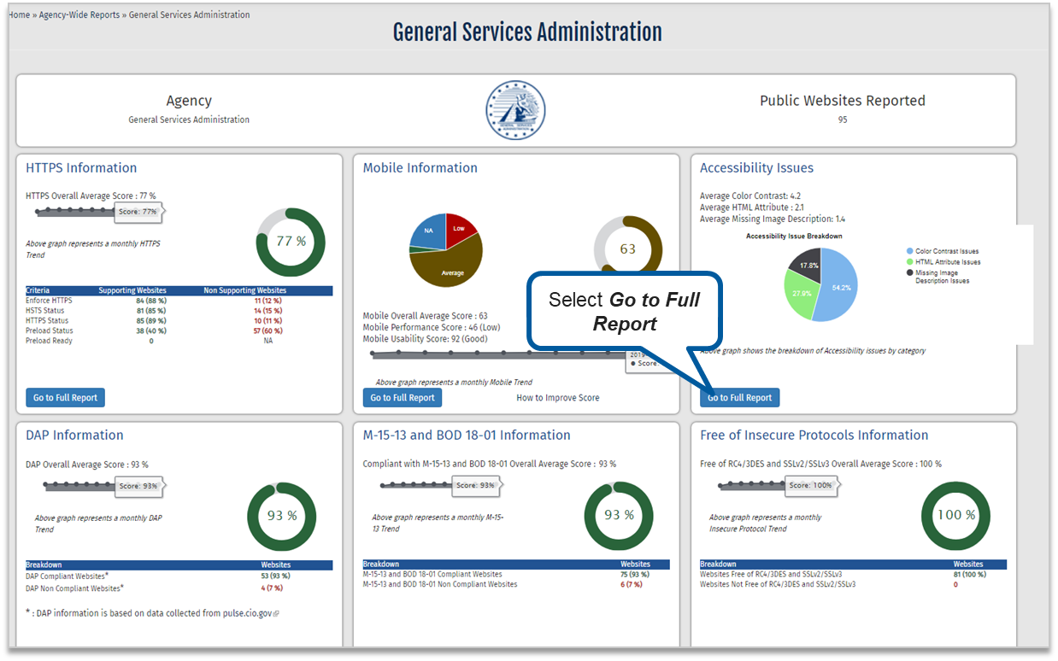
Agency Dashboard

Slide 23
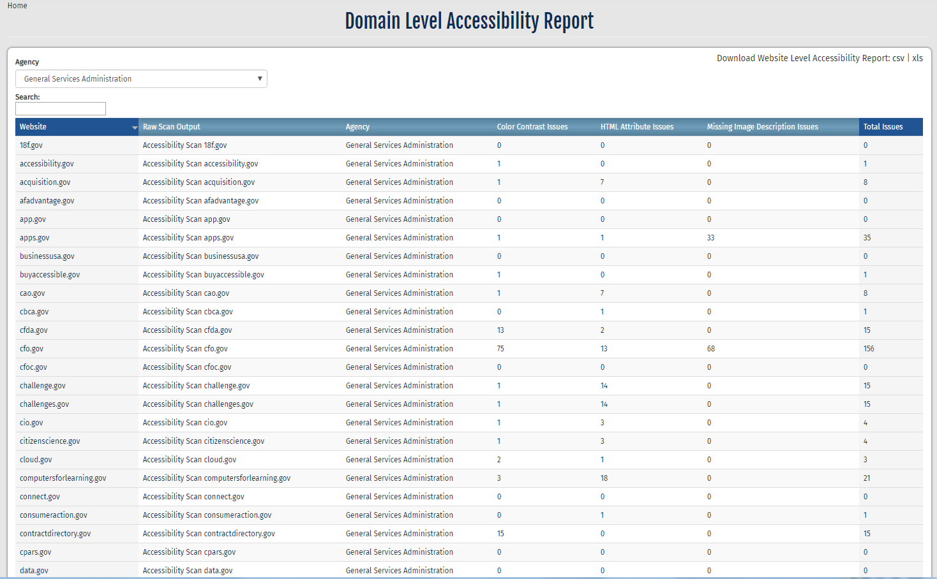
Domain-Level Accessibility Report
Search for a particular agency
Sort results by column headings
Export findings
Search by website name

Slide 24
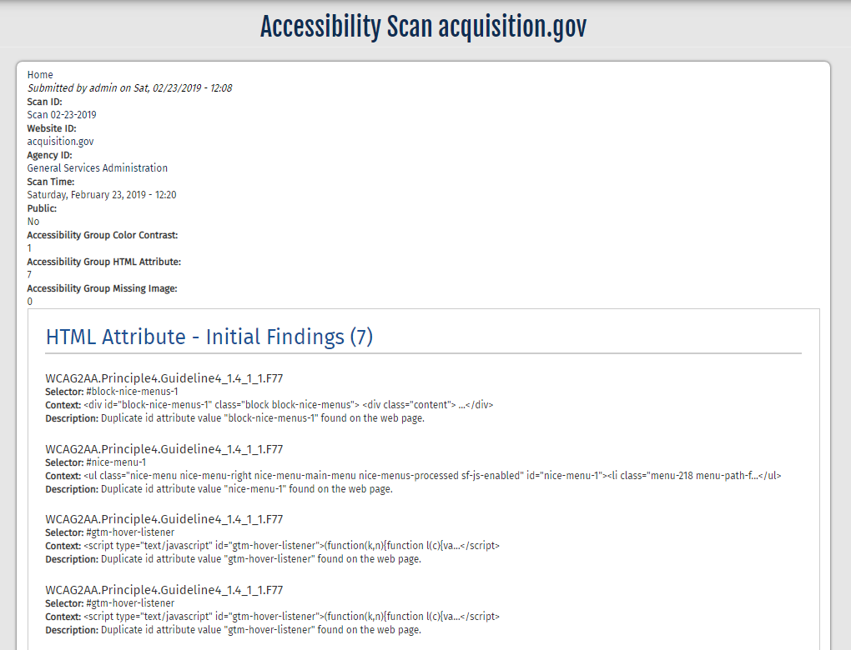
Accessibility Scan Example

Slide 25
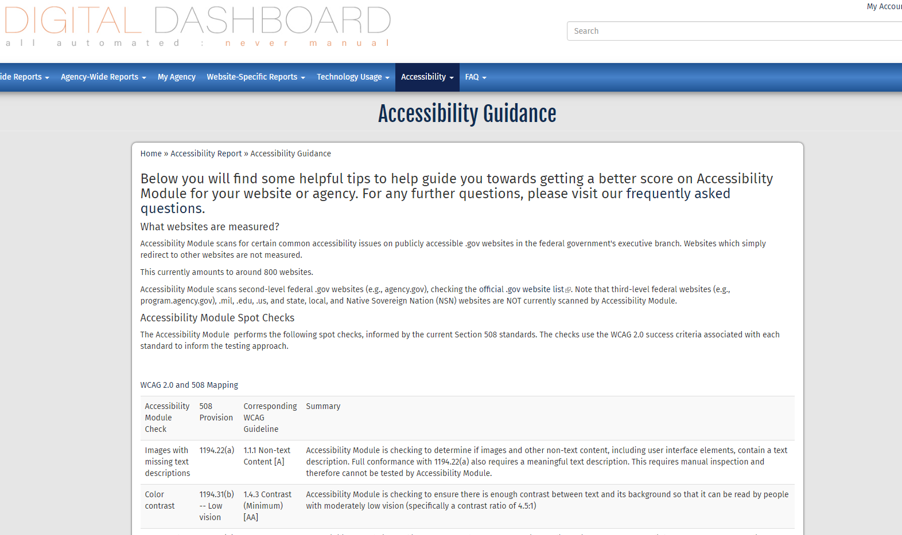
Accessibility Guidance

Slide 26
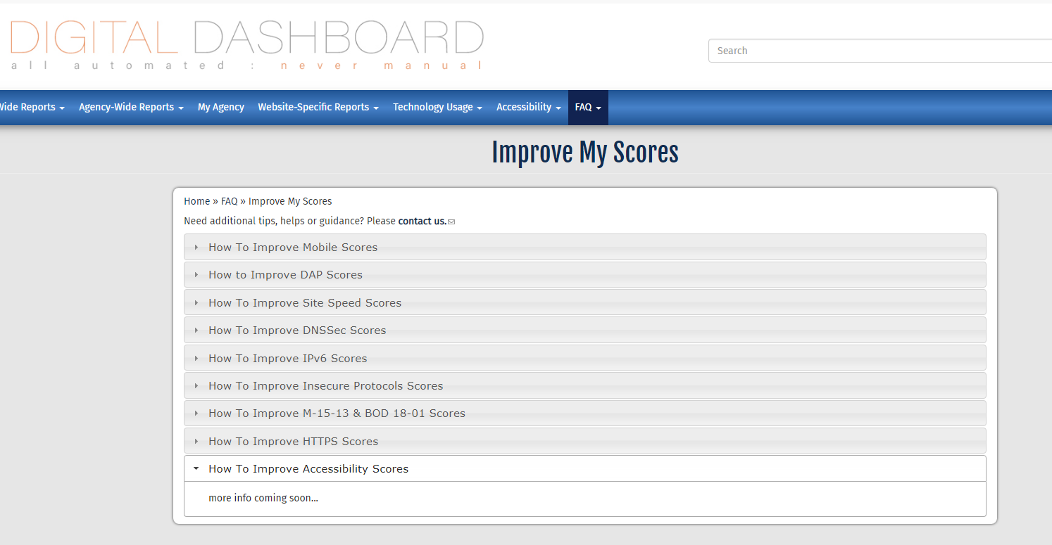
Improve My Scores

Slide 27

Live Demo
https://digitaldashboard.gov/

Slide 28
WARNING: The 3 website issues being tracked are just a TINY portion of the issues in which websites are evaluated.

Slide 29

Technical Support
Contact Section.508@gsa.gov for help with answering any questions that might arise while using the Digital Dashboard Accessbility Module.

Slide 30
Digital Dashboard
Expanding Website Accessibility Testing
Michael Horton | August 1, 2019

Slide 31
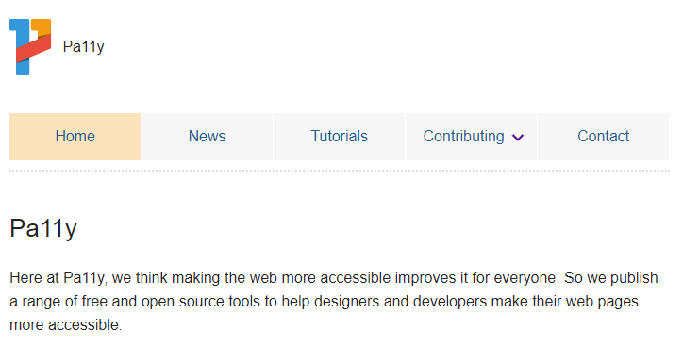
Accessibility Module is Powered by Pa11y
http://pa11y.org/

Slide 32
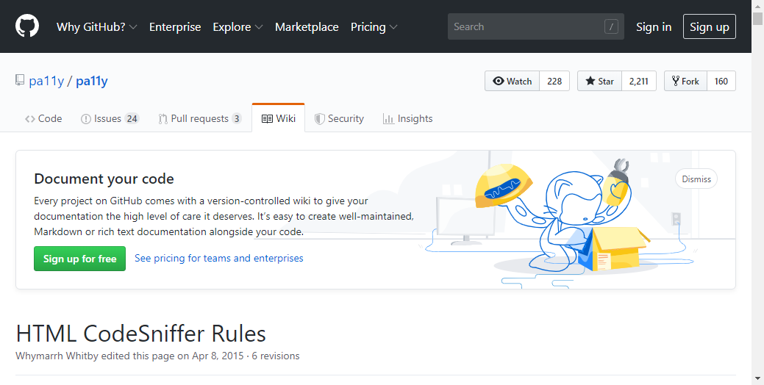
Pa11y Scanning Rules on Github
https://github.com/pa11y/pa11y/wiki/HTML-CodeSniffer-Rules

Slide 33
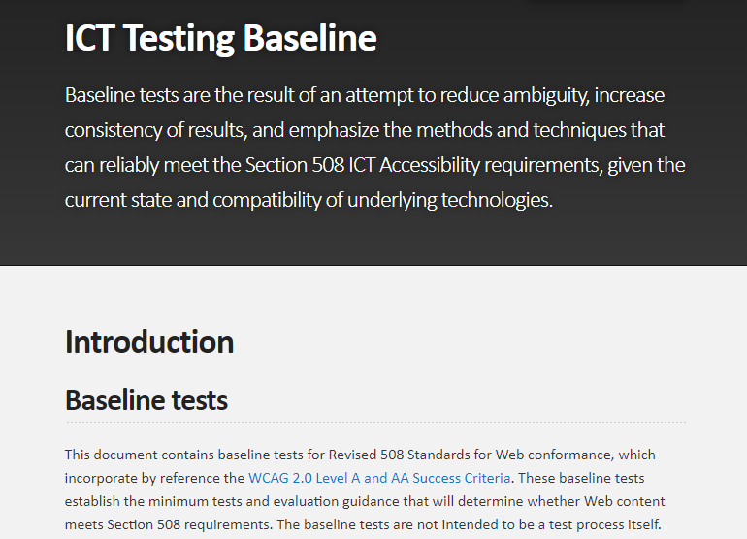
ICT Testing Baseline
https://section508coordinators.github.io/ICTTestingBaseline/introduction.html

Slide 34
Currently Scanned Issues
Color Contrast
HTML Attributes
Missing Descriptions
Identifies programmed elements where there is not enough color contrast between text and its background.
Identifies images and other non-text content that are missing a text description.
Identifies anchor elements with a valid attribute, but where no link content has been supplied.
Identifies anchor element with no link content and no name and/or ID attribute.
Conformance requires enough contrast so that text can be read by people with moderately low vision (specifically a contrast ratio of 4.5:1).
Full conformance requires that sufficient information about all user interface components is available to assistive technology.
Full conformance requires a meaningful text description. This requires manual inspection.

Slide 35
Align with ICT Testing Baseline
Issue
The code example below illustrates an issue. An HTML image element uses <img> as content for a hyperlink (<a>) yet no coding is included to provide a description or purpose for the hyperlink or the image elements:
<a title="" href="/"><img src="corplogo.png" width="50" height="50"></a>

Slide 36
Align with ICT Testing Baseline: Remediation
Although applying either one (only one is required) of the techniques below will result in conformance with ICT Testing baseline, in order to prevent an accessibility issue from being identified in included as an error in automated accessibility test tool reports that do not test for TT5 compliance, it is recommended that the alt text solution below be used as the first option for widest possible compliance:
Option 1: alt on <img>: <a href="/"><img alt="Target Home Page" src="corplogo.png" width="50" height="50"></a>
Option 2: title on <a>: <a title="Target Home Page" href="/"><img alt="" src="corplogo.png" width="50" height="50"></a>
Option 3: aria-label on <img>: <a href="/"><img alt="" aria-label="Target Home Page" src="corplogo.png" width="50" height="50"></a>
Option 4: aria-label on <a>: <a aria-label="Target Home Page" href="/"><img alt="" src="corplogo.png" width="50" height="50"></a>
Option 5: aria-labelledby on <img>: <span id="lbl1">Target Home Page</span>< a href="/"><img alt="" aria-labelledby="lbl1" src="corplogo.png" width="50" height="50"></a>
Option 6: aria-labelledby on <a>: <span id="lbl2">Target Home Page</span> <a aria-labelledby="lbl2" href="/"><img alt="" src="corplogo.png" width="50" height="50"></a>

Slide 37
Align with ICT Testing Baseline: Remediation (Continued)
Code Example: <a title="" href="/"><img src="corplogo.png" width="50" height="50"></a>
Conformance Option 1-alt on <img>: <a href="/"><img alt="Target Home Page" src="corplogo.png" width="50" height="50"></a>
Conformance Option 2-title on <a>: <a title="Target Home Page" href="/"><img alt="" src="corplogo.png" width="50" height="50"></a>
Conformance Option 3-aria-label on <img>: <a href="/"><img alt="" aria-label="Target Home Page" src="corplogo.png" width="50" height="50"></a>
Conformance Option 4-aria-label on <a>: <a aria-label="Target Home Page" href="/"><img alt="" src="corplogo.png" width="50" height="50"></a>
Conformance Option 5-aria-labelledby on <img>: <span id="lbl1">Target Home Page</span>< a href="/"><img alt="" aria-labelledby="lbl1" src="corplogo.png" width="50" height="50"></a>
Conformance Option 6-aria-labelledby on <a>: <span id="lbl2">Target Home Page</span> <a aria-labelledby="lbl2" href="/"><img alt="" src="corplogo.png" width="50" height="50"></a>

Slide 38
Working Group
Expanding Website Accessibility Testing
Objective: Set up a Working Group to assist the GSA OGP IT Accessibility Team in expanding the website testing and evaluations performed by the Digital Dashboard Accessibility module and to ensure testing output is in conformance with the ICT Testing baseline.

Slide 40
Update on the 2019
Interagency Accessibility Forum (IAAF)
John Sullivan & Yvette Gibson | August 1, 2019

Slide 41
Update on the 2019 Interagency Accessibility Forum (IAAF)
Interagency Accessibility Forum October 7-8 at the HHS Hubert H. Humphrey Building near U.S. Capital
Sponsored by the ACoP, co-hosted by HHS and GSA
Keynote by Tony Coehlo ex-Congressman, co-author of the Americans with Disabilities Act (ADA)
Will include key work stream workshops
Registration will open in early August
Watch your Email inbox for more information
Day-of volunteers needed!

Slide 43
Thank you! Have an accessible day!

